Slide 1
Intro to DPM
By Zhangliliang

Slide 2
Outline
Intuition
Introduction to DPM Model
Inference(matching)
Training
latent SVM
Training Procedure
Initialization
Post-processing

Slide 3
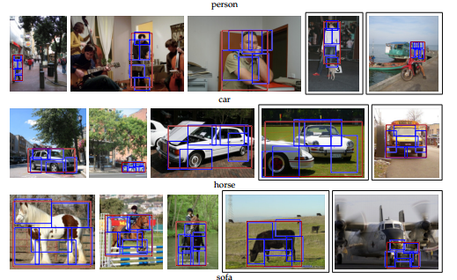
What is Detection?——location + class label

Slide 4
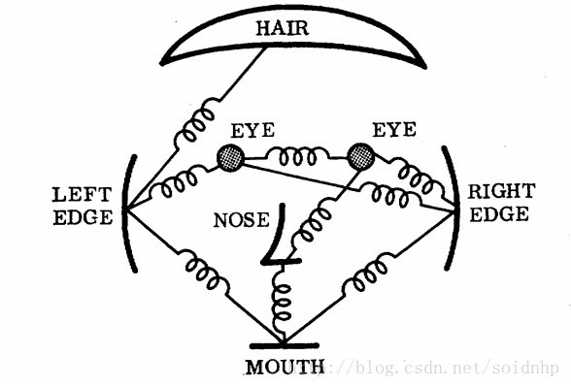
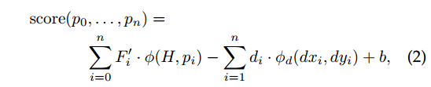
DPM——Deformable Part based Model
Root: the whole head
Parts: eyes, nose …
Deformation: the spring between root and parts

Slide 5
Discriminative Model
Discriminative vs Generative ?
Discriminative:
A score to predict the probability of a proposal
A threshold to divide the score as positive or negative
Root & Parts Filter scores
Parts Deformation loss
Bias

Slide 6

Linear Filter(Convoluation Kernel)
score = filter * input
i.e. Score = weight * feature

Slide 7
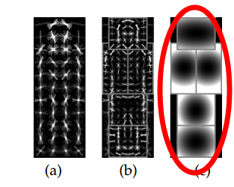
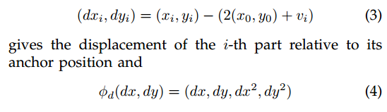
Deformation loss
L1 and L2 distance:

Slide 8
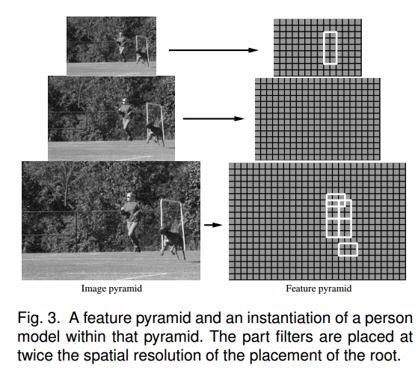
Why 2?

Slide 9

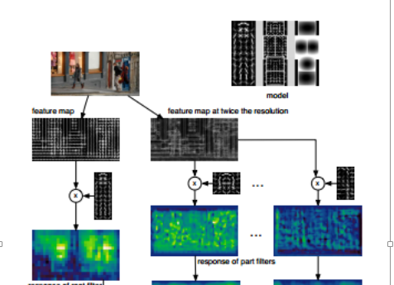
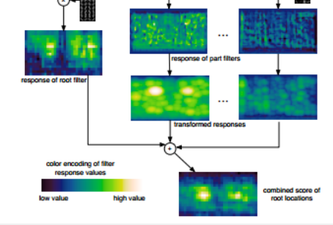
If we have a model, how to inference?
Dynamic Programming

Slide 10
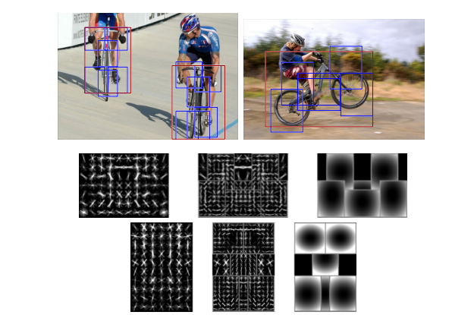
Mixture Model: Difference Pose and View

Slide 11
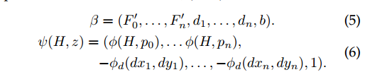
Formulate it as linear —— to use SVM
i.e. score = β·φ

Slide 12

Why latent SVM? ——Partial labelled
The dataset just contain the root bbox, but not the parts’ bbox.
Thus, the location of parts are unknown as LATENT.
Z means the latent variable.

Slide 13


Main Difference between SVM and LSVM
Convexity!
SVM ’s loss function is convex
LSVM’s loss function is semi-convex.
To the negative sample, LSVM’s loss function is convex
To the positive sample, LSVM’s loss function isn’t convex until the latent term is fixed
Thus, if we fix the latent term of positive sample, LSVM→SVM

Slide 14
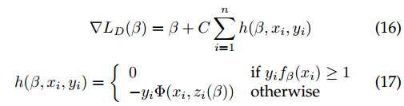
Coordinate Descent
Step 1: Relabel positive examples
Search the Z(x) of each positive example to find out the best z, and retain it.
Step 2: Optimize beta
Now the loss is convex, we can use normal optimal solution to solve the SVM
Here the author use SGD to solve it.

Slide 15
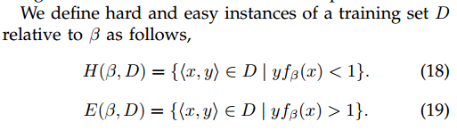
Data-mining the hard negative
Why? ——The negative examples are too many.
Thus, we need to mining the effective negative ——“hard” negative
Whether it is easy or hard?
If the LSVM can classify it correctly and confidently, it’s easy.
Otherwise, it’s hard.

Slide 16
More detail about data-mining hard negative
We need a cache to save the positive and negative examples.
Boostrapping Procedure:
1) for each positive example to find out the best z. Then retain them in the cache
2) Add negative to the cache until the cache is full
3) Train a model
4) Use the model to test the negative in cache, shrink the easy ones.
5) Add hard negative to the cache until the cache is full
6) repeat 3-5 until there are not hard negative can be found.

Slide 17
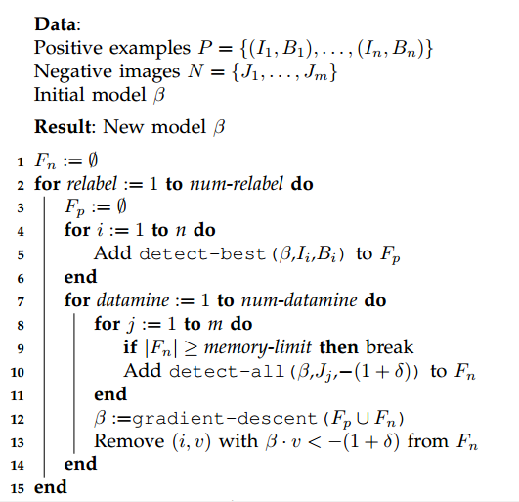
Training procedure
How to generate the positive example?
How to generate the negative example?
The whole view of training procedure?

Slide 18
Post-processing
Bounding Box Prediction
Non-Maximum Suppression
Contextual Information

Slide 19
Reference
DPM project: http://www.cs.berkeley.edu/~rbg/latent/
My Note: http://zhangliliang.github.io/2014/09/01/paper-note-dpm/
Other Note: http://blog.csdn.net/pkueecser/article/details/8012007
Other Note2: http://blog.csdn.net/masibuaa/article/details/17534151

Slide 20
THANK

